Slide 1
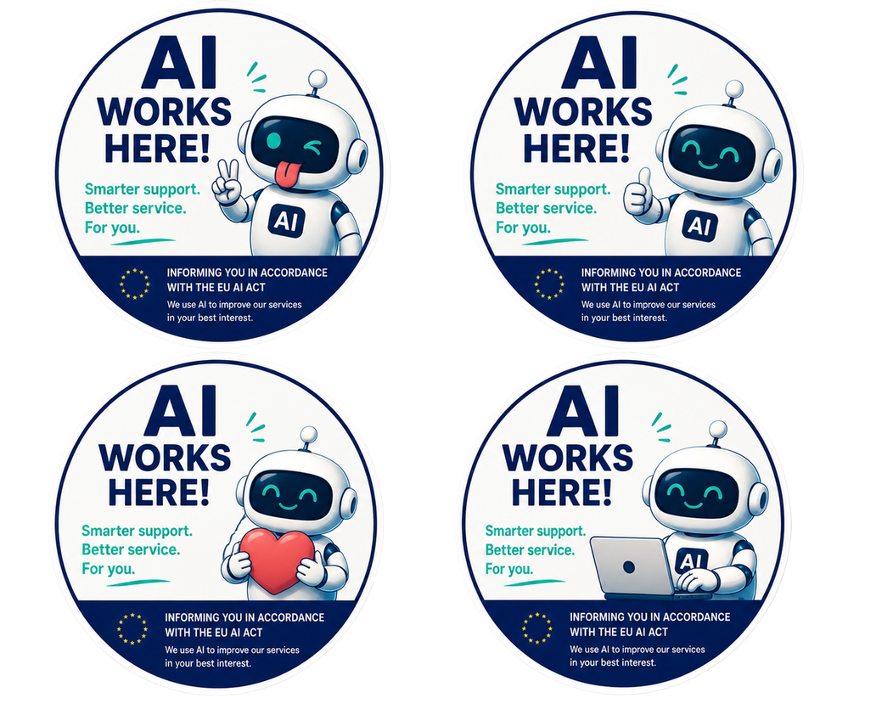
AI-BUSINESS · KIT
How to tell your clients
you have adopted AI
A ready kit: an owner's guide and 10 warm templates that turn the
AI announcement into a gesture of care for your clients.
aibusiness.vc | Sergei Ponomarev | info@aibusiness.vc
Kit: telling clients about your AI

Slide 2
THE BIG IDEA
It is care for your client, not a checkbox
Adopting AI is a great chance not just to meet a legal requirement, but to show your clients they matter most. Do not inform dryly - care.
Thank them. Tell them they are your best clients and you work for them
INSTRUCTION
Show the care. Explain the AI is here to answer them faster and better
Reassure. A human is always available, with a person responsible for the AI
Invite dialogue. Ask for their ideas on what to improve in your products
This turns the AI news into a gesture of care and builds loyalty.
aibusiness.vc | Sergei Ponomarev | info@aibusiness.vc
Kit: telling clients about your AI

Slide 3
HOW TO USE
What is in the kit
Take the template you need, replace the [placeholders] and publish. Each one is a ready product on its own.
Social media post
publish the announcement card
Can and can't
sets realistic expectations
INSTRUCTION
One-pager for your site
a fuller explanation on one page
FAQ
answers to common AI concerns
Email to clients
send it by email or newsletter
You are chatting with AI notice
disclaimer for chat and site
Rights card
client rights in one image
Client guide
how to use it, step by step
How we handle your data
a plain-language privacy notice
AI works here badge
a sign for offline
Important: these are templates. Rewrite any of them for yourself with your own AI and add real details about your company.
aibusiness.vc | Sergei Ponomarev | info@aibusiness.vc
Kit: telling clients about your AI

Slide 4
WHAT THE LAW REQUIRES
What you must disclose about AI
Say it is AI
Tell the client up front that they are talking to AI, not a human.
Mark AI content
Label AI-made text, images, audio and video, and especially deepfakes.
INSTRUCTION
Warn about analysis
If the AI reads emotions or profiles people, say so.
Right to a human and an explanation
Let clients reach a person and explain a decision that affects them.
Collect no more than needed
Ask only for the data the service actually requires.
EU AI Act Art. 50 and 86 (from 2 Aug 2026, fines up to EUR 15M or 3% of turnover); US: California, Utah, Maine, Colorado. Guidance, not legal advice.
aibusiness.vc | Sergei Ponomarev | info@aibusiness.vc
Kit: telling clients about your AI

Slide 5
DATA AND THE LAW
Data: what the law requires
A lawful basis
Process data only on a lawful basis; for sensitive data and AI training, get the client's consent.
Purpose and minimum
Use data only for the stated purpose and ask only for what the service needs.
INSTRUCTION
Retention period
Set a retention period and auto-deletion; keep it no longer than needed, and disclose that period.
A clear notice
In plain language: what you collect, why, how long you keep it, whether you record chats and train AI on them.
Rights, security, vendor
Access, rectification, deletion; data security; a processing agreement (DPA) with the AI platform.
GDPR and the EU AI Act; US: CCPA/CPRA (disclose what you collect and the retention period). Guidance, not legal advice.
aibusiness.vc | Sergei Ponomarev | info@aibusiness.vc
Kit: telling clients about your AI

Slide 6
GOOD ROLLOUT CHECKLIST
How to do it well: a checklist
Persona without deception
Give the assistant a name and a simple avatar, but do not pass it off as human: no photo or name of a real employee.
Obvious human handoff
A Talk to a human button in plain sight, one tap; the AI passes context to the agent so the client need not repeat.
INSTRUCTION
Notice up front
Say it is AI before or at the very start of the chat, not at the end.
Opt-out
Let clients opt out of the AI and of recording and training on their data; honour deletion.
Accessibility
Plain language, screen-reader support, an alternative channel for those uneasy with AI.
Gradual and listening
Roll out in stages, gather feedback and improve.
Good delivery builds trust: clients want to know about AI in advance, not catch you running a hidden bot.
aibusiness.vc | Sergei Ponomarev | info@aibusiness.vc
Kit: telling clients about your AI

Slide 7
Social media post
Dear clients,
You matter to us most. Everything we do, we do for you, and we keep looking for ways to make our service even better, faster and more convenient.
We are happy to share good news: we have added an AI assistant, [Assistant name]. Now you get answers faster, any time of day and with no queues. It can… [what it does].
We did it honestly and with care for you. You always see that you are talking to AI, and at any moment you can switch to a real person. [Owner] is personally responsible for the assistant.
Most of all, your opinion matters to us. Tell us what we can improve and strengthen in our products and services. Your ideas shape what our service becomes.
Thank you for being with us! Questions and feedback: [contact]. Learn more: [link].
SOCIAL POST
Replace the [placeholders]. Publish as an image on social media.
aibusiness.vc

Slide 8
We have adopted AI - with care for you
Dear clients! You are the reason we work and grow. Thank you for being with us. We keep improving our service, and this next step of that care is adopting artificial intelligence.
Why we did it. To answer you faster and better, save your time and be available around the clock, with no queues or waiting.
Who helps you. A smart assistant, [Assistant]. It [what it does]. You always know it is AI, not a person.
A human is always near. At any moment you can switch to a person: [how to reach a human]. [Owner] is personally responsible for the assistant.
Your data is protected. We ask only for what the service needs, store it carefully and never use it against you.
If something is wrong. Write to [contact]. We will look into it, and a person will review any disputed decision.
Your ideas matter. Tell us what to improve in our products and services - we truly read every message and act on it.
Thank you for choosing us. We value every one of you.
ONE-PAGER
Replace the [placeholders]. Put it on your site page How we use AI.
aibusiness.vc

Slide 9
Email to clients
Subject: we care about you and are adopting AI
Hello, [Name]!
First of all, thank you for being with us. You are one of the clients we make our service better for every single day.
We are glad to share: [Company] has adopted artificial intelligence to answer you faster, better and at any time. On [channel] you can now be helped by our smart assistant, [Assistant].
We are always honest when AI is talking to you, and at any moment you can switch to a real person. [Owner] is responsible for the assistant, [contact] - write to us if anything is wrong. We protect your data and ask only for what the service needs.
Most importantly, we really want to hear you. Tell us what we can improve and strengthen in our products and services - your ideas directly shape what our service becomes.
More on how we use AI and what your rights are: [link].
With gratitude, the [Company] team.
EMAIL
Replace the [placeholders]. Send by email or newsletter.
aibusiness.vc

Slide 10
Your rights when working with our AI
We use AI honestly and on your side. Here is what you always have:
Talking and decisions
Know that you are talking to AI, not a human
Switch to a person at any moment
Opt out of AI and talk only to a person
Clear explanations in plain language
An explanation of a decision that affects you
A human review of that decision
Equal access, with no discrimination
Your data and protection
Know what data the assistant uses
Know the purpose, sources and storage terms
Get a copy of your data and fix any errors
Not give data beyond what the service needs
Opt out of recording and training on your data
Protection: your data is not used against you
Complain, get a reply and compensation for harm
RIGHTS CARD
And most of all - we welcome your ideas on what to improve: [contact].
aibusiness.vc

Slide 11
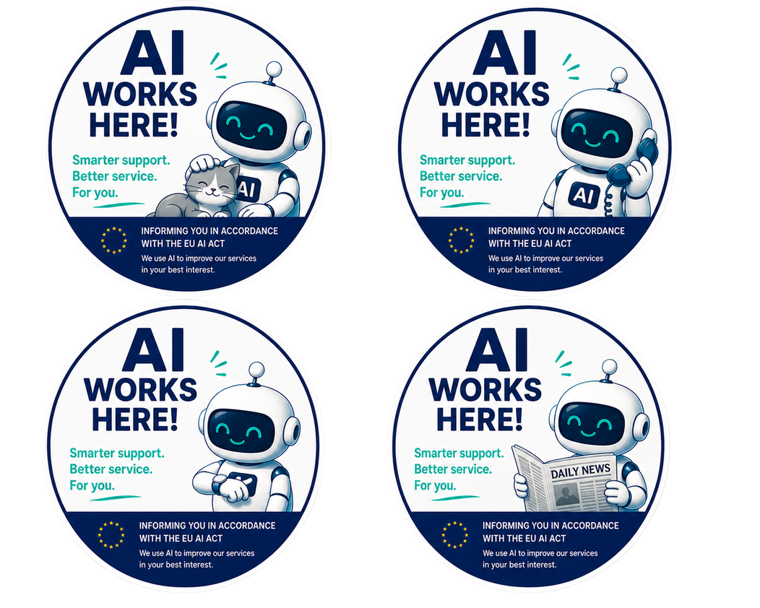
How we handle your data
Briefly and honestly about your data:
What we collect. [what data: e.g. name, contacts, request history].
Why. Only to serve you and answer faster. We do not sell it or share it needlessly.
How long we keep it. [period, e.g. 12 months], after which we delete it.
Recording, quality and training. We may record chats for quality control. For AI training we [use only anonymised data with consent / do not use it].
Who else has access. Our AI platform [vendor] processes data under a contract; we do not pass it to others.
Your rights. Know what we hold about you, get a copy, correct it and delete it.
Responsible for data. [contact].
HOW WE STORE DATA
Replace the [placeholders]. This is your plain-language privacy notice - it meets a legal duty.
aibusiness.vc

Slide 12
What the assistant can and cannot do
We are honest so you know what to expect. Either way, we are here for you.
It can
Answer questions about products, services and orders
Advise from our knowledge base around the clock
Quickly find the information you need
Tell you the status of your request or order
Help you file a standard request
Switch you to a real person right away
It cannot (people do)
Make important decisions for you
Accept or process your documents
Handle money, payments and refunds
Resolve complex disputes or edge cases
Give legal, medical or financial opinions
A real person always helps here
CAN & CAN'T
These are examples. Replace them with what your assistant really can and cannot do.
aibusiness.vc

Slide 13
Frequent questions about our AI
Is this really AI, not a person?
Yes. We always tell you honestly, and you can switch to a person at any moment.
Is my data safe?
Yes. The assistant sees only what the service needs and never uses your data against you.
How do I reach a human?
[how to reach a human] at any time. [Owner] is responsible for the assistant.
What if the AI makes a mistake?
Write to [contact]. We will sort it out, and a person will review any disputed decision.
How can I suggest an improvement?
Write to [contact]. We read every message and truly improve the service from your ideas.
FAQ
Replace the [placeholders]. Add your own frequent questions.
aibusiness.vc

Slide 14
You are chatting with AI notice
You are chatting with
a virtual AI assistant.
It helps you faster. Need a person?
Tap Talk to a human at any time - we are always here.
CHAT NOTICE
A short disclaimer for your chat widget or site. It meets the duty to say it is AI and shows care.
aibusiness.vc

Slide 15
How to use the assistant
We made the assistant simple to save your time. Here is how it works:
Steps:
Find the assistant: [where: chat on the site, app, by phone].
Ask in plain words, as you would a person. No commands needed.
Add details: order number, date. That makes the answer precise.
Get an answer right away. Not clear? Ask to clarify or simplify.
Answer not right? Ask it to rephrase.
Switch to a person any time: [how to reach a human].
Good to know:
The assistant is available around the clock, with no queues.
It is always clear it is AI, not a human.
Your data is safe, it will not ask for anything extra.
Money, documents and complex disputes go to a person.
If anything is wrong, a human is always near.
Your ideas make the service better: [contact].
CLIENT GUIDE
Replace the [placeholders]. Give it to clients when they first meet the assistant.
aibusiness.vc

Slide 16
AI works here badge
AI works here
We adopted it with care for you, to help faster.
A real person is always near. Learn more: [link]
OFFLINE BADGE
A sign or sticker for your office, door or desk. This badge is easy to finish in Canva.
aibusiness.vc

